Slide 1

Agenda
Preprocessor Directives
Digraphs and Trigraphs
1

Slide 2
Preprocessor Directives
WHAT ARE THEY ?
Begins with ‘#’ symbol
Invoked by the compiler, before the compilation of source code
Not terminated by semicolon, unlike the statements of the code
Only one directive per line; cannot be combined
Should be stated in the code, before they are invoked
Used to include predefined library files, define macros, enable conditional compilation, to display error messages, etc
18-Sep-21
2

Slide 3
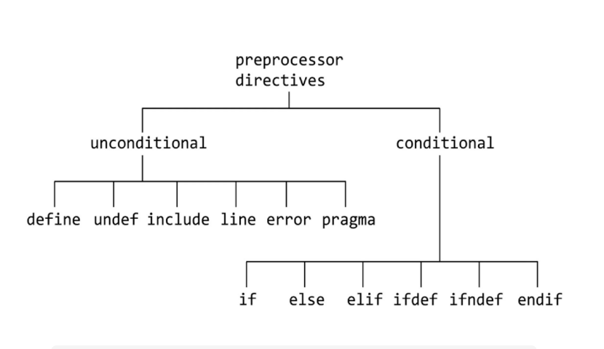

Slide 4
Preprocessor Directives
TYPES OF DIRECTIVES:
Name of the directive | Purpose
# include | to include library files
# define | to define symbolic constants, define macros
#if , #elif, #endif | for conditional compilation
#ifdef, #ifndef | conditional definition of symbolic constants
#error | To print an implementation dependent message
#pragma | For implementation dependent action

Slide 5
Preprocessor Directives
#include directive
– loads the file specified in the directive into the application environment
Two formats used:
– #include <filename>
Used to include predefined library files
System defined directories are searched to include the specified file
Eg.,
#include <iostream>
#include <cstring>
#include “filename”
Used to include user-defined files
Searches for the file in the current working directory, as that of the program file
Most often used header files, structure definitions, function declarations may be
defined in a file and included using this directive
Eg.,
#include “headers.txt” #include “functions.cpp”

Slide 6
Preprocessor Directives
#define directive
– Used to create symbolic constants and macros
Syntax
#define <Name of constant> <value assigned>
Symbolic constants
Often used standard common values may be designated using this
directive
Remains global and accessible to all the functions in the program
All instances of the constant replaced with the value, on compilation
Cannot be modified, once defined
Name given in capital letters, as a convention; not mandatory
– Eg.,
#define PI 3.1415
#define SZ 500
#define LT 200

Slide 7
Preprocessor Directives
#define directive
Macros
Used to define simple expressions
May be with or without arguments
Occurrences of the constant replaced with the expression, upon
compilation of the code
Data type checking not done
Expression to be parenthesized to maintain the logical correctness of
the computation
Eg., #define AREA(x,y) x * y
area = AREA(a+2,b+3) will be interpreted as area = a + 2 * b + 3 which is wrong
The correct use is #define AREA(x,y) ((x) * (y))

Slide 8
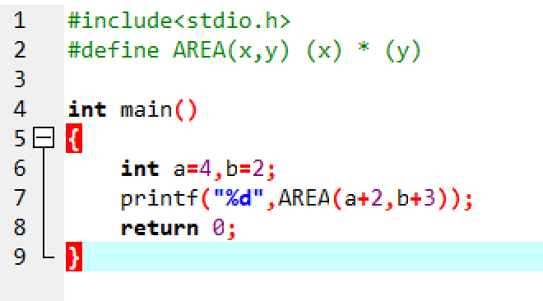
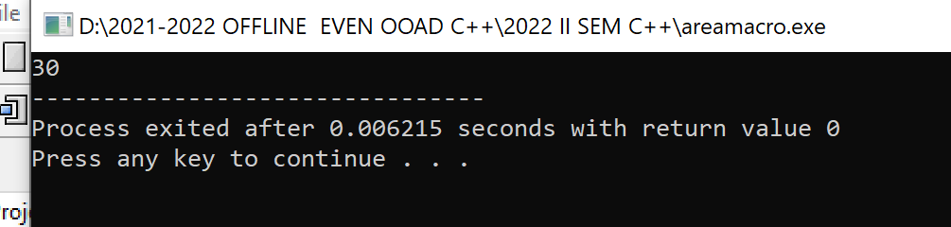

Slide 9
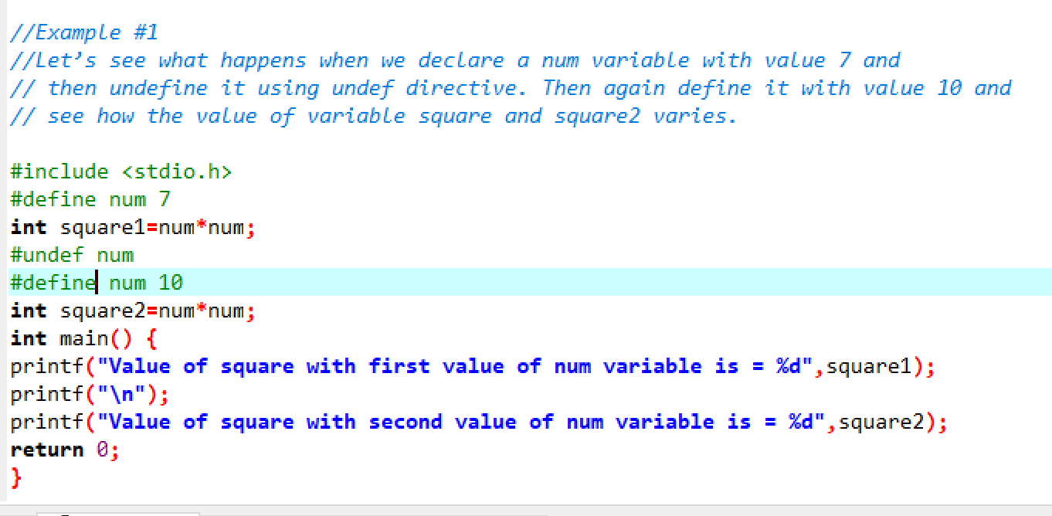
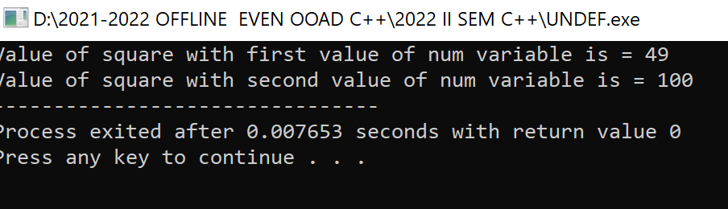
Preprocessor Directives
#undef directive
Used to undefine the macro
tells the preprocessor to remove all definitions for the specified macro
Macro definition ceases to exist from the point where undef is used
Can be used to redefine the macro within the same program at various points
Example:

Slide 10
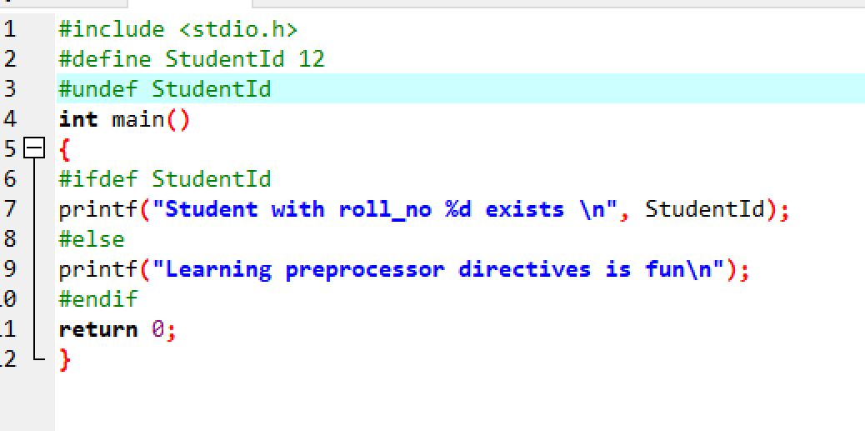
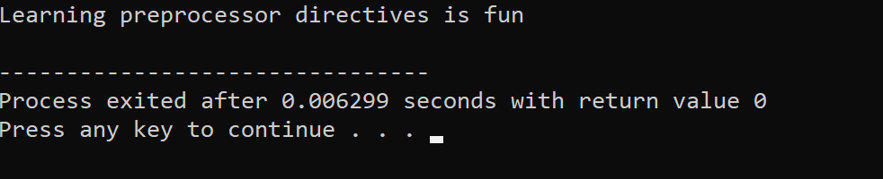

Slide 11
Preprocessor Directives
#if ….. #endif
Used for conditional compilation
#if when used, always to be ended with #endif
#elif directive used as equivalent of else…if statement
#else used equivalent to else clause in if statements
Normally used to avoid including the header files several times in the
same code file
Example:
#if !defined(MAX) #define MAX 500 #endif | #ifndef MAX #define MAX 500 #endif

Slide 12
Preprocessor Directives
#elif ….. #else
– Used for nested if checking
Example:
#include <iostream> using namespace std; #define FACTOR 5 main()
{
#if FACTOR < 5
printf("LESS THAN 5"); #elif FACTOR == 5
printf("EQUAL TO 5");
#else
printf("GREATER THAN 5");
#endif
}
Compile and run

Slide 13
Preprocessor Directives
#if 0 ….. #endif
Can be used to comment out a portion of the code
Used in place of /* …… */ for commenting a block of code
Enclosed statements will not be included for compilation
Example:
#include <stdio.h>
main()
{
#if 0
int x=10;
printf(“%d,&x);
#endif
printf("Iam here");
}
// SYNTAX ERROR
– Replace #if 0 with #if 1 to include the enclosed block in compilation

Slide 14
Preprocessor Directives
#if ….. #endif
Can be used for debugging purpose, where debugger not available
Used to print the values of variables
Can be removed after the completion of debugging
Example:
#ifdef CHECK
printf( “Result = %d\n", result); #endif
CHECK should have been defined before #ifdef
Can be removed once the value has been printed and verified

Slide 15
Preprocessor Directives
# and ## Operators
– # operator causes a replacement text to be converted to a string within
double quotes.
Example:
#define WELCOME(arg) printf(“WELCOME\t” #arg);
– A statement as WELCOME(PARENTS)
printf(“WELCOME “PARENTS”);
gets converted to
during compilation
– #arg is replaced by “PARENTS”
## operator needs two tokens
Example:
#define STRCAT(a,b) a##b
– A statement like STRCAT(ONE, TWO) is replaced by ONETWO during the compilation process

Slide 16
Preprocessor Directives
#line directive
Used to give line numbers to the source code following the directive, starting from the integer specified
Line numbers do not appear in the source code
Helps in making the error messages more meaningful
Example:
#line 50
Numbers the lines, starting with 50 from the next line in the code
A file name can also be included in the directive
#line 100 “Myfile.c”
Numbering to be started from 100 in the file named Myfile.c

Slide 17
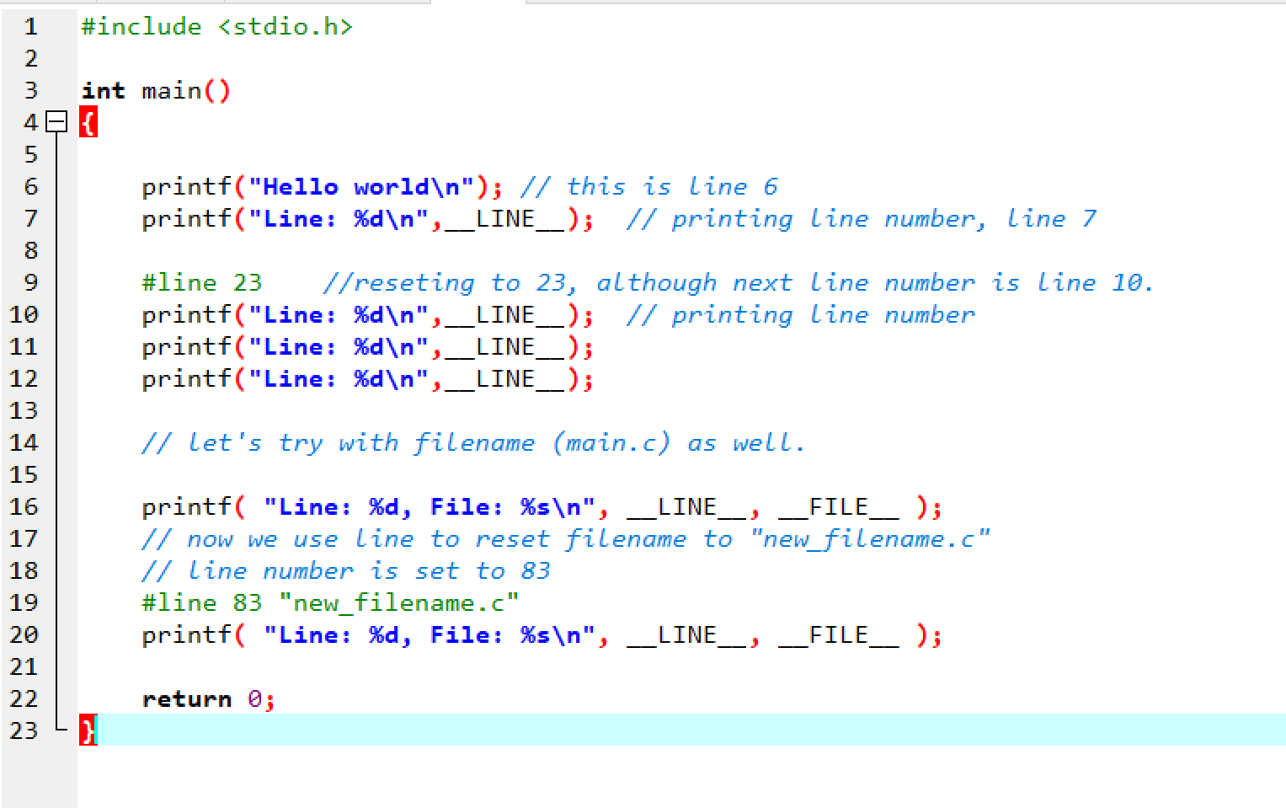

Slide 18
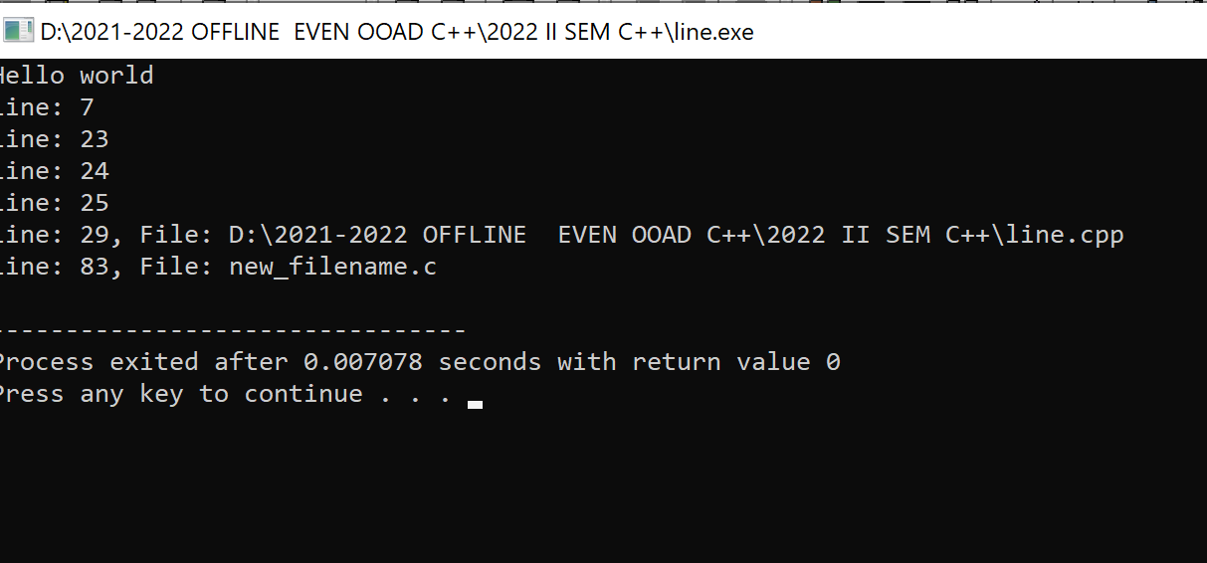

Slide 19
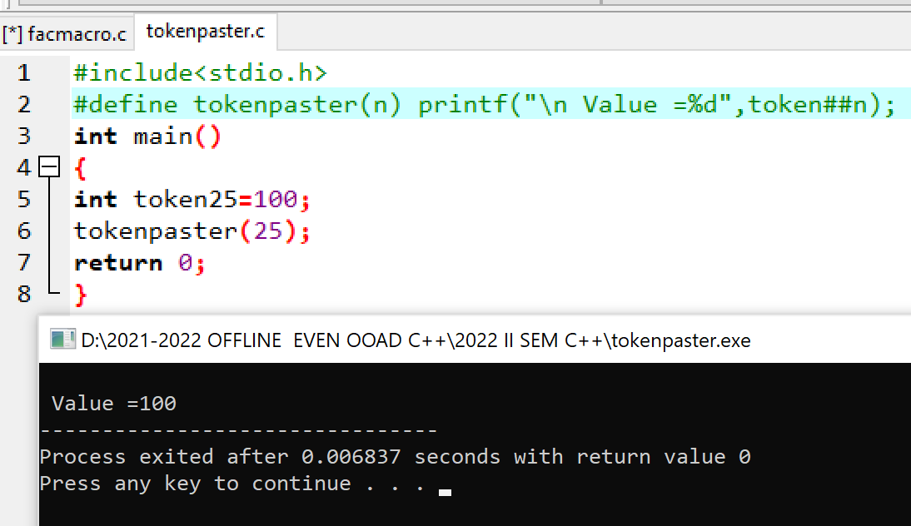
## in macro c

Slide 20
Preprocessor Directives
#error directive
– Prints an implementation-dependent error message using the tokens
specified in the directive
Example:
#error Invalid arguments supplied
– When an error is encountered, a message is displayed using the tokens given in the directive and the compilation stops

Slide 21
Digraph and Trigraphs
Digraph →Sequences of two characters
Trigraph → sequences of three characters
Interpreted even if they appear inside string literals
Treated as a single character
Optional in compiler settings; needs separate installation; can be turned on or off
Usage may be often confusing
18-Sep-21

Slide 22
Trigraph sequences
– Trigraphs always starts with a question mark
Trigraph | Replacement
??= |  | #
??/ |  | \
??' |  | ^
??( |  | [
??) |  | ]
??! |  | |
??< |  | {
??> |  | }
??- |  | ~
18-Sep-21

Slide 23
Digraph sequences
– Handled during tokenization
Digraph | Equivalent
<: | [
:> | ]
<% | {
%> | }
%: | #
%:%: | ##
18-Sep-21

Slide 24
Summary
Pre-processor directives
Digraph and trigraph sequences
18-Sep-21

